Slide 1
DATA VISUALIZATION
PROFESSOR:- TEMIDAYO OSATUYI
Done By:- Karthikeya Bobba
GUID:- 3186070
Project Type:- Individual
Project On:- COVID-19 Behaviors

Slide 2
COVID-19 US Tracking Dashboard
Power BI Visual Summary
Data Source: USAFacts, CDC

Slide 3
Dashboard Overview
This dashboard includes the following visuals:
Bar Chart: COVID-19 metrics by state (Confirmed Cases, Deaths, Fatality Rate)
Choropleth Map: State-level confirmed cases and deaths
Line Charts: Daily trends of confirmed cases and deaths
Data Source and Methodology (USAFacts and CDC)

Slide 4
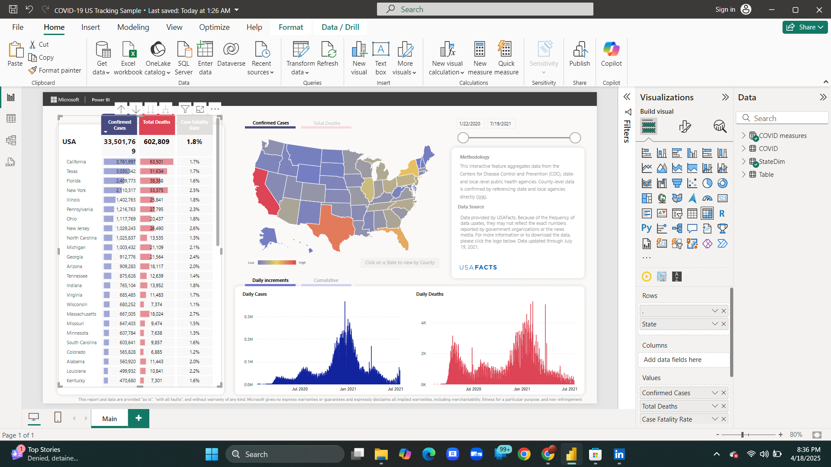

Slide 5
Bar Chart: State-wise COVID-19 Metrics
This horizontal bar chart compares U.S. states on three key metrics:
Confirmed Cases: Total number of reported COVID-19 cases
Total Deaths: Death toll attributed to COVID-19
Case Fatality Rate: Percentage of deaths relative to confirmed cases

Slide 6
Choropleth Map: Geographic Impact
The interactive map provides a visual breakdown of COVID-19 cases or deaths by state:
Color intensity shows the magnitude of cases or deaths
Users can click on a state to explore county-level data
Helps identify regional hotspots and trends

Slide 7
Line Charts: Daily COVID-19 Trends
Line charts show the daily increments in cases and deaths:
Daily Cases: Visualizes spikes and waves in infection rates
Daily Deaths: Helps track fatality trends over time
Useful for monitoring surges and recovery phases

Slide 8
Data Source & Methodology
The data and methodology used in this dashboard include:
Data aggregated from the CDC and state/local public health agencies
County-level validation ensures localized accuracy
Dashboard reflects data available up to July 19, 2021
Source: USAFacts.org

